Slide 1
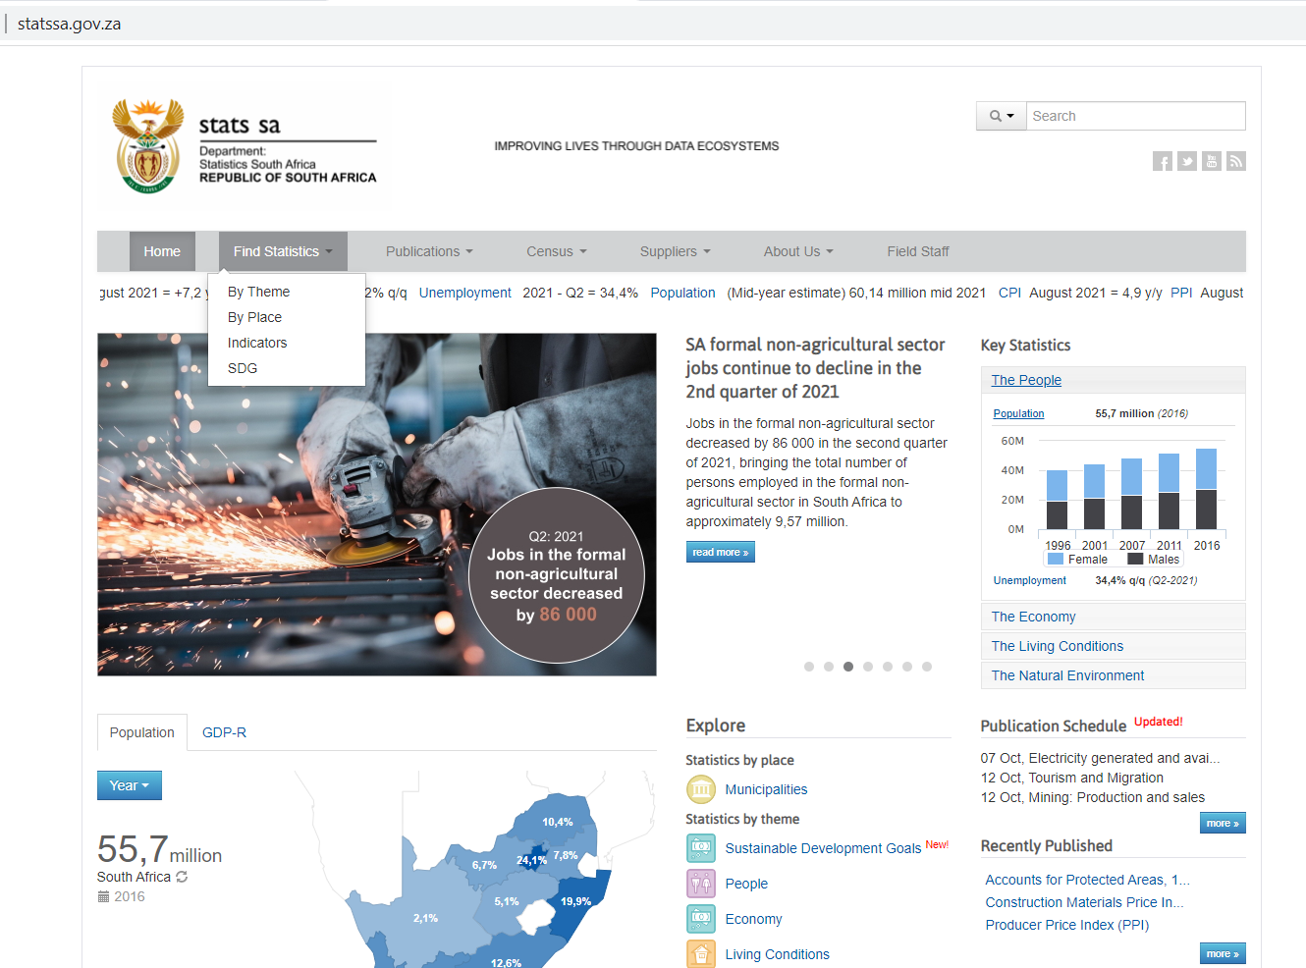
Procedure to obtain LCI data for South Africa
Go to:
Go to “Find Statistics” and then select “By Theme”
http://www.statssa.gov.za/

Slide 2
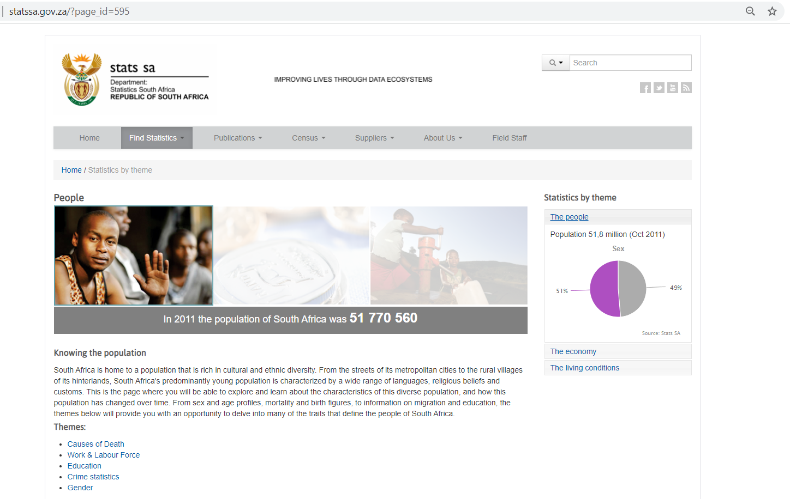
Procedure to obtain LCI data for South Africa
Select “Work & Labor Force”

Slide 3
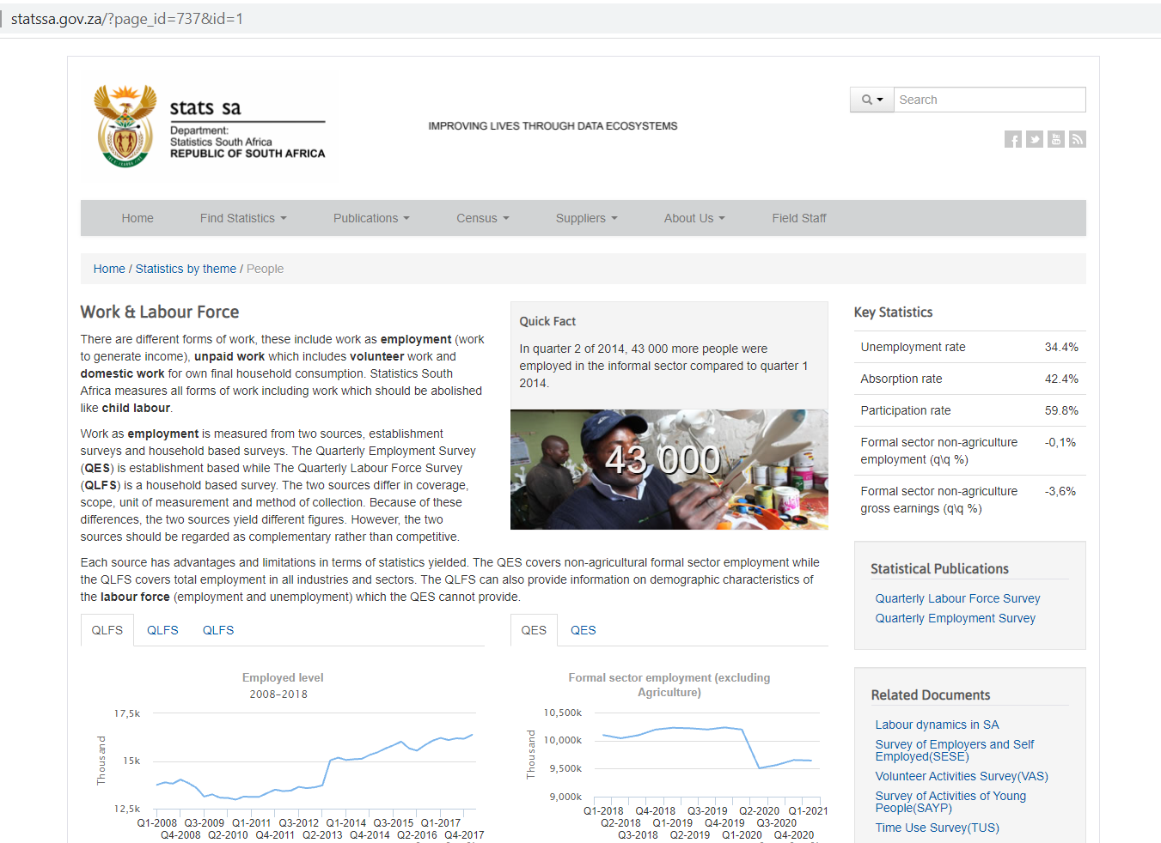
Procedure to obtain LCI data for South Africa
Select “Quarterly Employment Survey”

Slide 4
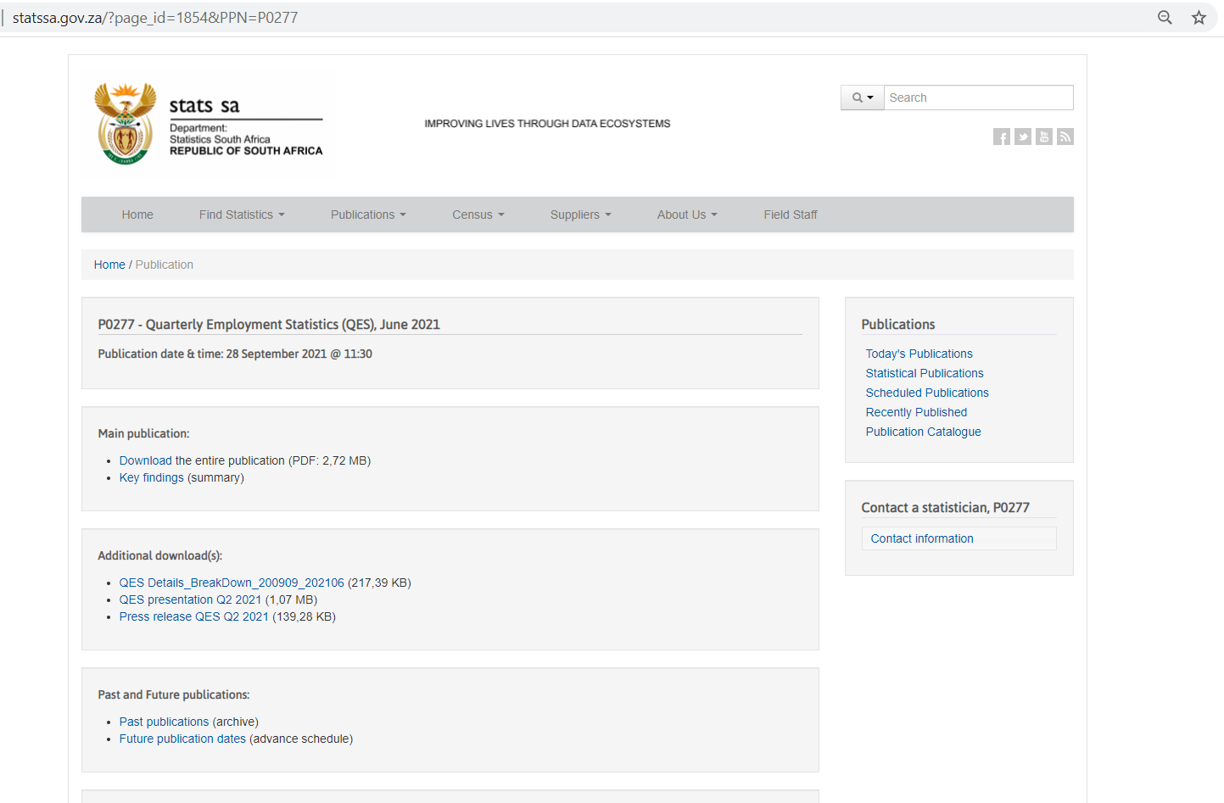
Procedure to obtain LCI data for South Africa
Download the Excel File titled “QES_Details_BreakDown_200909_202106”

Slide 5
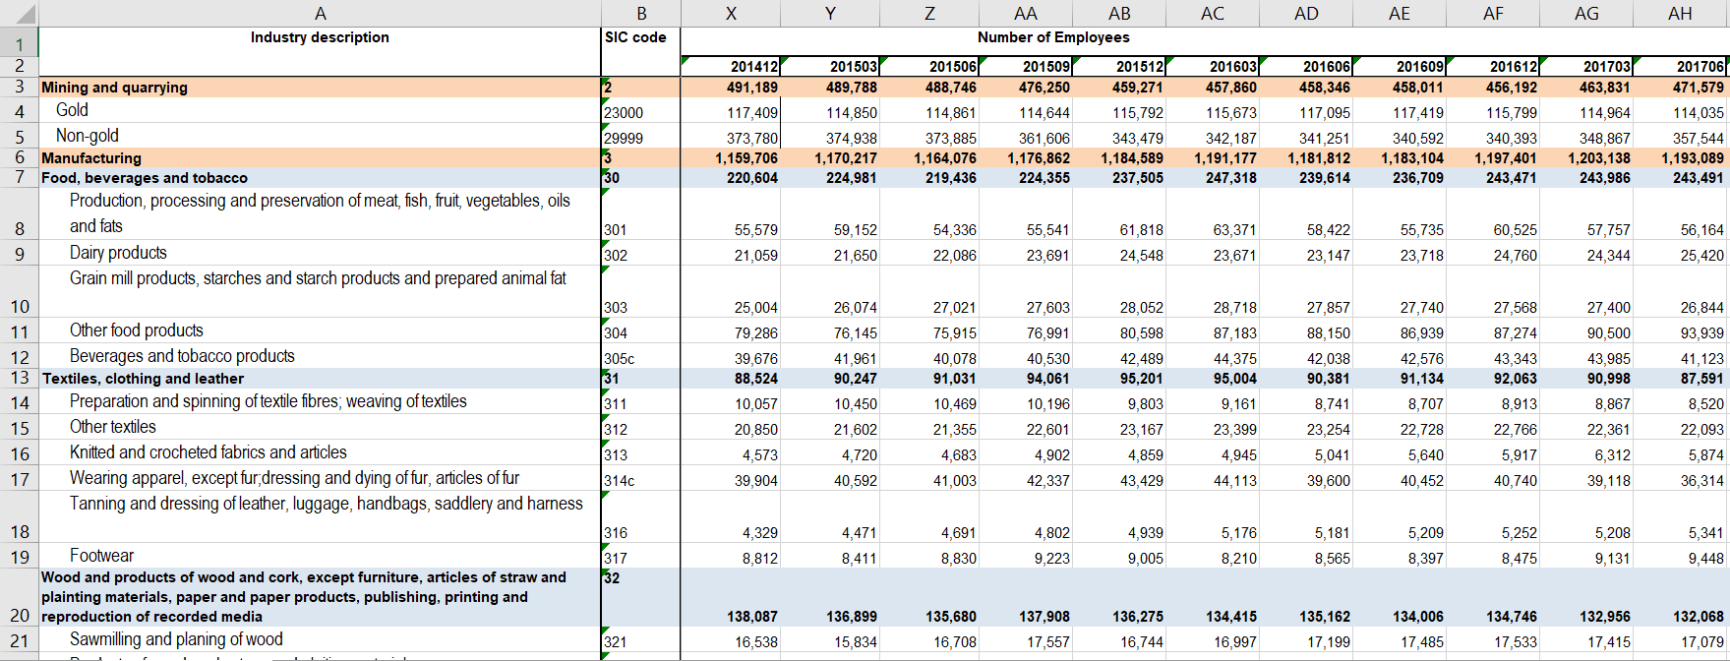
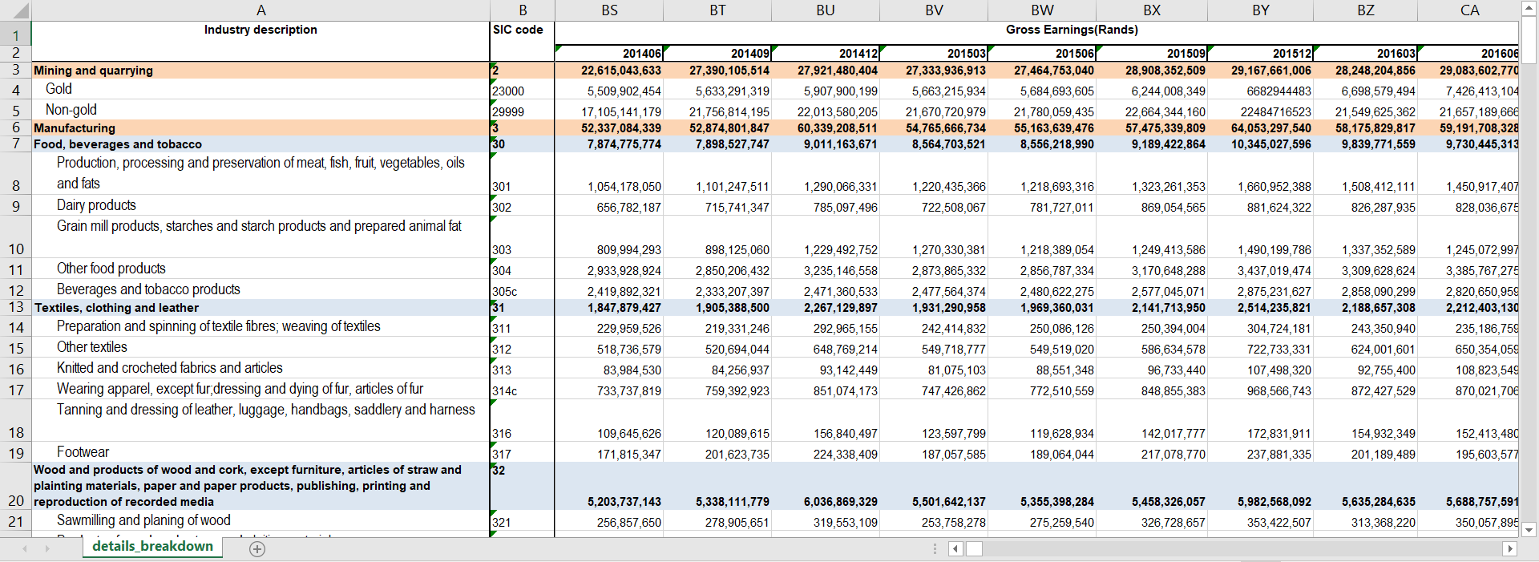
Procedure to obtain LCI data for South Africa
Open the Excel file titled “QES_Details_BreakDown_200909_202106”
The first table contains data for the “Number of Employees” per industry
As you scroll to the right side of this excel sheet, you will find table 2 which contains “Gross Earnings per quarter”

Slide 6
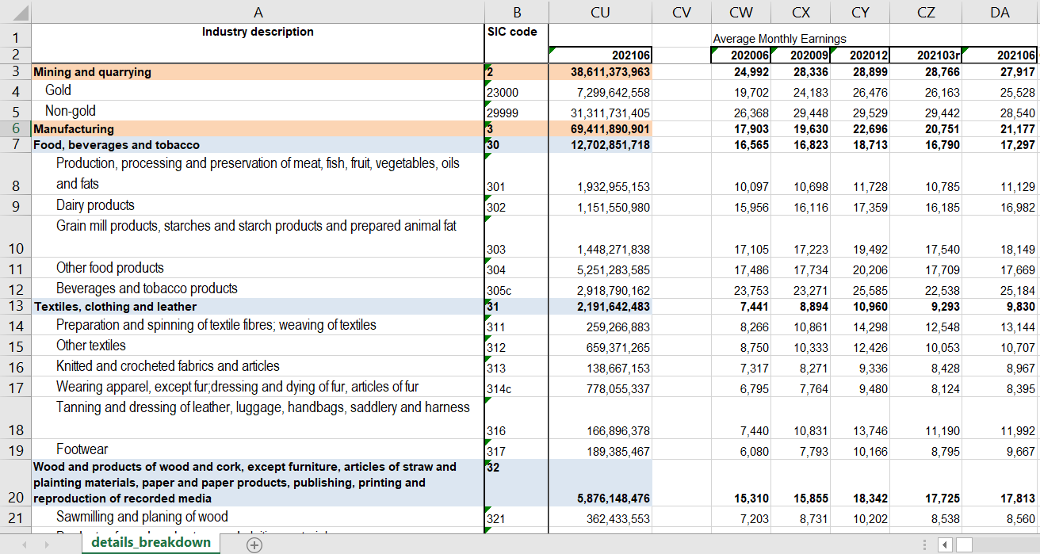
Procedure to obtain LCI data for South Africa
In order to calculate the “Average Monthly Earnings” for the latest quarter, divide the “Gross Earnings” for the latest quarter by the “Number of Employees” for the latest quarter
Avg Monthly Earnings= Gross Earnings/No of Employees
Repeat this procedure for the previous 5 quarters

Slide 7
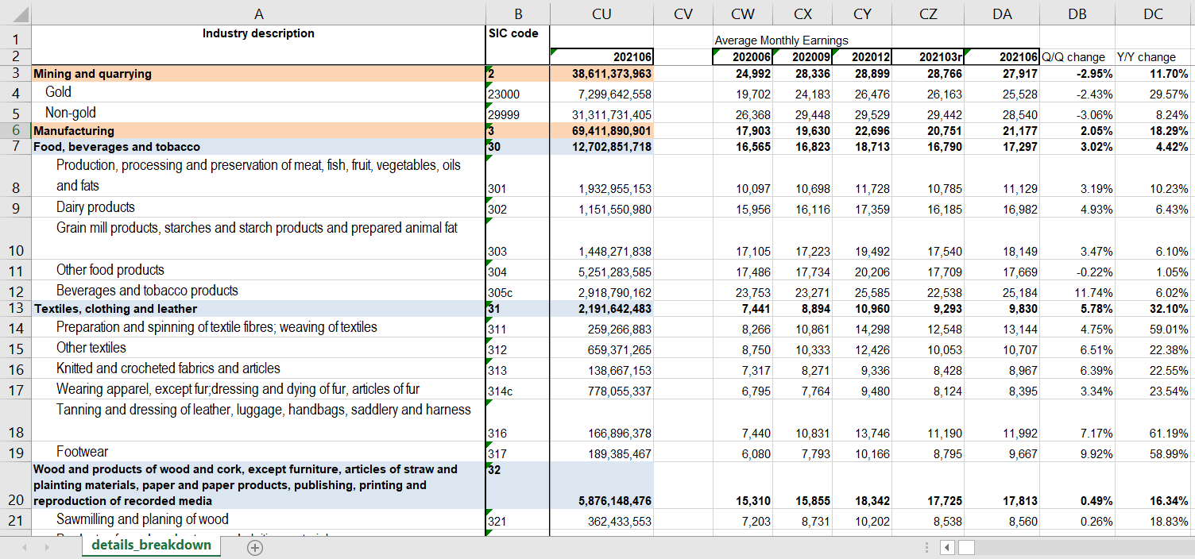
Procedure to obtain LCI data for South Africa
Calculate the Percentage Change in Average Monthly Earnings from Quarter to Quarter as follows:
Q/Q Change = (202106-202103r)/202103r
= (27917-28766)/28766
= -2.95%
Repeat this procedure for all industries

Slide 8
Procedure to obtain LCI data for South Africa
Calculate the Percentage Change in Average Monthly Earnings from Year to Year as follows:
Y/Y Change = (202106-202006)/202006
= (27917-24992)/24992
= 11.70%
Repeat this procedure for all industries

